Slide 1
Replacing IS/LM with a IS/TS
Lecture 11
April 22/2020

Slide 2
Replacing IS/LM with a modern day apparatus:
IS: investment/Saving curve. This remains the cornerstone.
a change in the RELEVANT real rate changes I and, in turn, Y
What is the relevant real rate??? In the IS/LM world, there is only one interest rate, the “bond” yield.
No distinction is made between risky and risk free bond rates.
No interest is paid on money like instrument

Slide 3
How does the LM curve work?
Money demand reflects two considerations:
We keep money on hand, to transact—to buy stuff.
We keep money balances low, to the degree that we feel
we are losing out on interest returns from bonds.
The Fed EXOGENOUSLY establishes the level of real money, (M/P)
When they provide more money, there are ample funds to allow for transactions and bond purchases, bond prices rise, yields fall, output rises

Slide 4
Why is IS/LM, a 1937 invented apparatus, close to Useless?
The Fed can put reserves in the system, and not affect loan creation and real GDP. (see 2008-2010)
The Fed targets interest rates, not the supply of money
The Fed targets the short term rate, usually.
When the Fed tightens, money market rates rise, investors move toward money like investments, not away, and long rates rise.

Slide 5
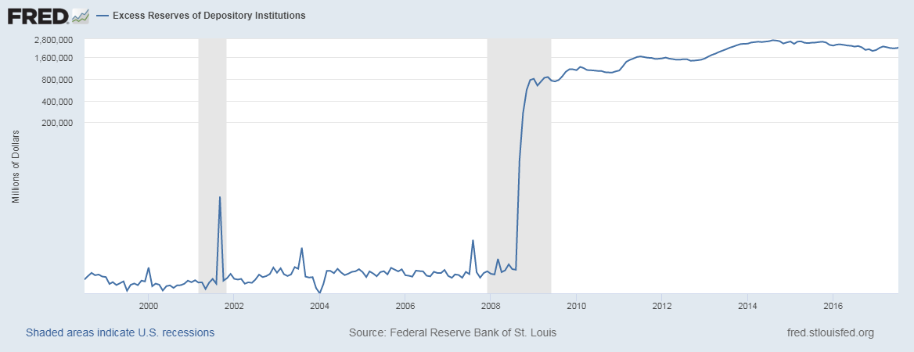
Excess reserves: $1.5 billion average, 1999 through 2007 Excess reserves: $2.5 trillion average, 2010-2015

Slide 6
How real world based, macro strategists might think about monetary policy:
The Fed (usually) targets the risk free, short rate.
This influences the risk free long rate.
Both influence the risky long rate.
The risky long rate drives the economy.

Slide 7
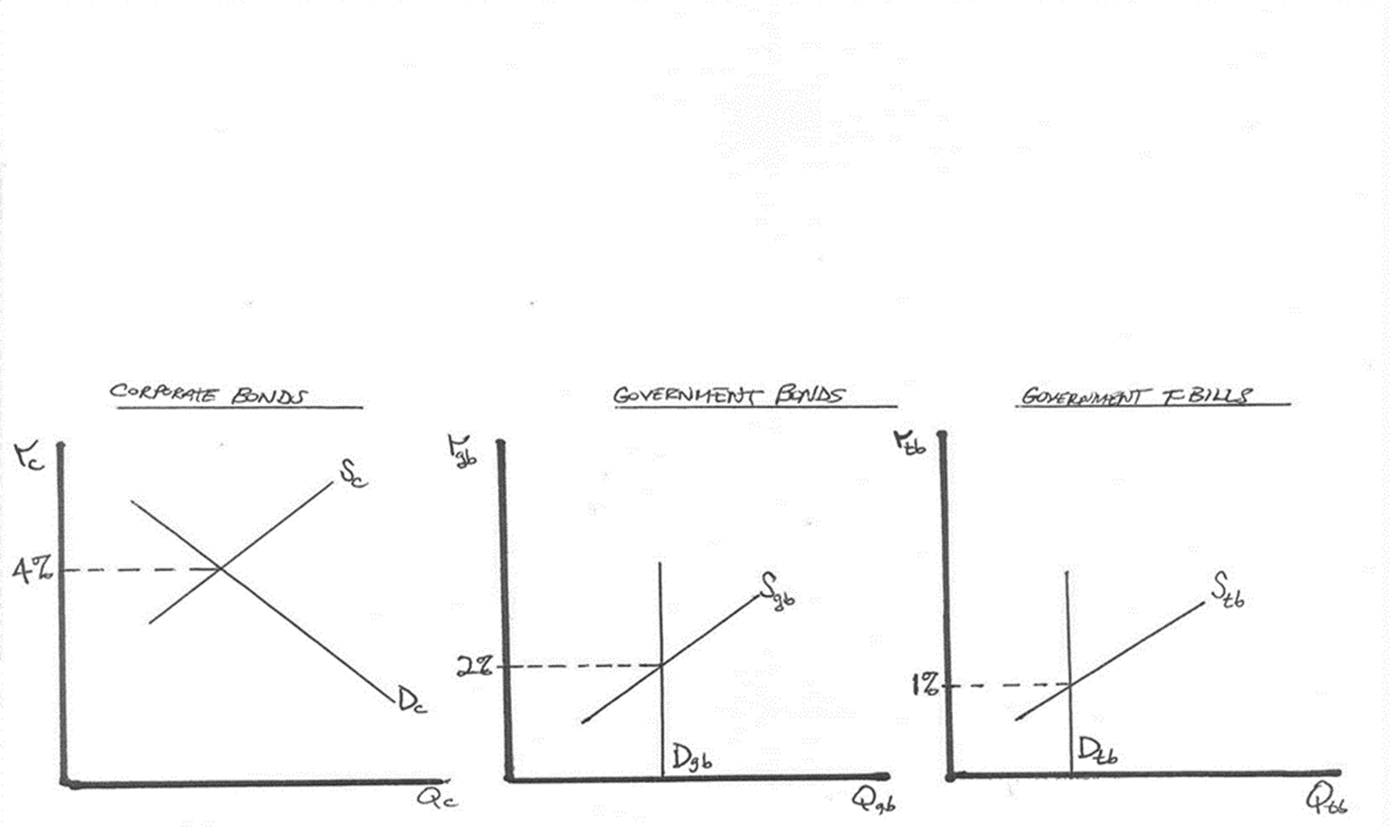
In a loanable funds space it looks like this:

Slide 8
What about using the banking model?
Banks tend to borrow money, of short duration
money market fund type accounts
CDs
Banks tend to lend longer term
loans to corporations
mortgages to home buyers

Slide 9
How do they decide whether to lend to a prospective borrower?
Do they call up and see how much money they have in their vault? No!
They calculate their cost of funds—how much interest they must pay to make the loan.
They determine the interest rate the borrower is willing to pay.
The difference? Their NET INTEREST MARGIN.
They then decide if that margin justifies making the loan.

Slide 10
How can we explain $2.5 trillion in bank excess reserves, that collect ZERO interest?
Cost of funds? ZERO
Only very risky borrowers, with very high bankruptcy issues, want to borrow, and they can only borrow at 5%
Suppose a 1-year loan at 5%, and you lend to 100 borrowers:

Slide 11
We can use that frame in a model that includes Y and π?
We preserve the IS curve, but we are specific about what interest rate drives it.
We preserve the Phillips Curve.
We create a new curve: the TS curve
The TS curve relates changes in the risk free short rate—the Fed’s target rate—to changes in the interest rate that drives I and Y

Slide 12
REPEAT: How real world based, macro strategists might think about monetary policy:
The Fed (usually) targets the risk free, short rate.
This influences the risk free long rate.
Both influence the risky long rate.
The risky long rate drives the economy.

Slide 13
We will build two versions of a model.
The Wicksell Model: this will champion free markets
The Minsky/Wicksell model: requires an active Fed
(next week’s lecture)

Slide 14
The Wicksell TS curve
R = ω (f+$τ$ ) + (1- ω)W
R = risk-free real long term rate (10-year TIPS yield)
f = real fed funds rate (fed funds rate minus TIPS breakeven π) in
$τ$ = term premium (normally 0.8% or 80 basis points)
W = risk-free Wicksellian natural rate (5-year/5-year forward TIPS yield)
ω = weight factor for Fed policy (expectations for duration of Fed policy)

Slide 15
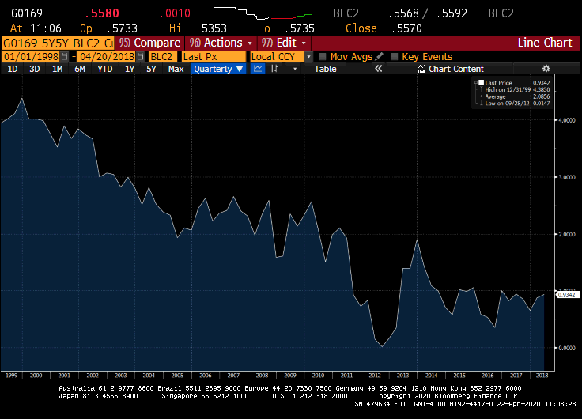
W≡ Wicksellian risk-free natural rate

Slide 16
$τ$ = term premium 10-year/fed funds spread averages 80 basis points expected future rates understate forwards the difference? The term premium

Slide 17
R = ω(f+$τ$) + (1- ω)W what does the equation mean?

Slide 18
How would we define equilibrium for Federal Reserve Policy?
Our Taylor Equation says that when Y and π are at target r = r*
r* = neutral real fed funds rate
W= neutral real risk free long rate
f* = W- $τ$ (the neutral real funds rate equals the Wicksellian natural rate minus the average term premium)
f* = (5-year/5-year forward TIPS yield minus 0.8)

Slide 19
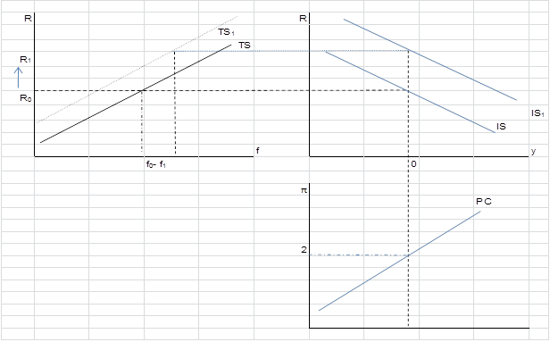

Slide 20
The key observation? The Wicksell model is equilibrium seeking.
A Modified Taylor rule, reflecting the Wicksell concept
We acknowledge that r* varies:
fed funds = π + 0.5(π – π*) + (U*-U) + W-τ

Slide 21
Repeat: W≡ Wicksellian risk-free natural rate

