Slide 1
A Theory of Investment Demand,
An Expanded Loanable Funds Model
4/15/20

Slide 2
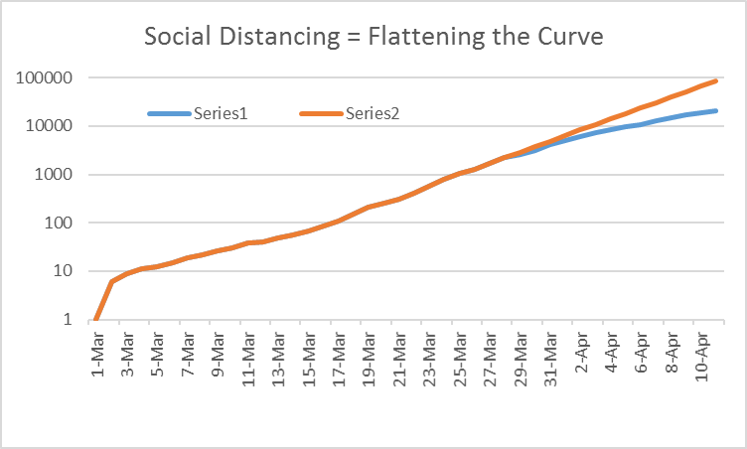
Cumulative Deaths: A Clear Flattening,
Beginning in Late March
(100,000 extrapolation vs 20,000 reality)

Slide 3
Deconstructing the Flattening:The Five hot spots were virulent.
The Rest of the Country? Very Little Infection Introduction
So how do we, even partially, re-open the Nation for business?
(as of 04/12/20)

Slide 4
Total hours worked were flat, Q1 vs. Q4 real GDP???

Slide 5
March retail sales suggest a big drop for Q1:PCEs. Suppose real GDP at a 3% annualized rate
Growth in real GDP = Growth in labor hours + Growth in labor force
-3% = 0 + Growth in labor force

Slide 6
For Q2:2020, we cannot use our shorthand approach: Suppose hours fall by 15% and labor productivity falls by 5%
∆% Y = %∆ labor productivity + %∆ labor hours
= -5% + -15% = -20%
But the mathematically precise formula:
1.??% = (1-5%) × (1-20%) = .76% = -24%
AND THAT IS BEFORE ANNUALIZATION

Slide 7
.

Slide 8
THINK OF AN OIL SHALE DRILLER,
REALITY AS OF 2/10/20
REALITY AS OF 4/15/20

Slide 9
WOULD YOU DRILL A WELL, THAT SPEWS OIL FOR THE NEXT 5 YEARS?

Slide 10
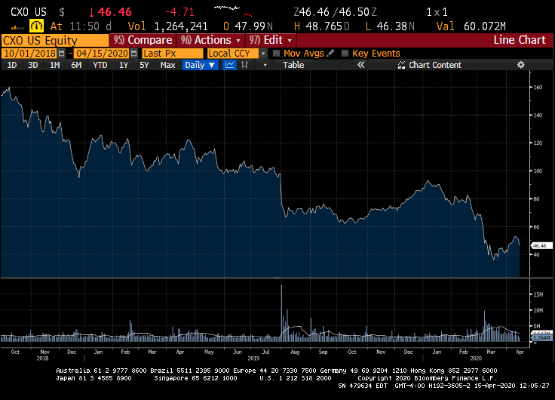
Concho: a fracking based oil driller in Texas its share price, over the last 18 months:

Slide 11
Want to own an oil drilling company?
What does the Q ratio tell you to do?
.

Slide 12
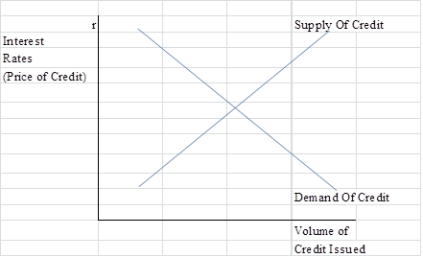
The Basic Loanable funds Model and Wicksell's Natural Rate

Slide 13
The natural rate of interest: the borrowing rate that delivers a Goldilocks
(not too hot, not too cold) economy

Slide 14
The loanable funds model, expanded to three interest rates:
We create a model with three interest rates:
r_{c} the real long term borrowing rate for corporations
r_{g} the real long-term borrowing rate for the government
Fed monetary policy is tied to a third interest rate:
r_{f} the real short term interest rate: the real fed funds rate.

Slide 15
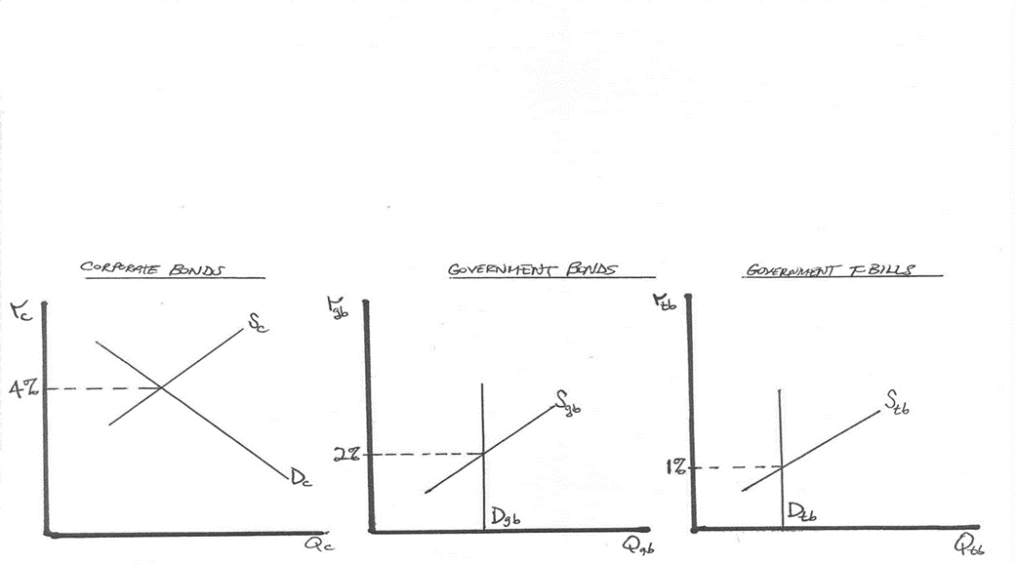
.

Slide 16
We net Fed actions, when figuring out houeholds’ need to finance government debt.
Corporations demand funds in the corporate bond market:
D_{c} ≡ demand of Corporations’ for funds in the corporate bond market
Government demand for funds: TOTAL vs. PRIVATE
Federal Reserve Buys and Sells Government Debt
Government’s Private Demand for funds:
Net of Federal Reserve Transactions.

Slide 17
Four Actors: Households, Government, Federal Reserve, Corporations.
Three Interest Rates : r_{f} r_{g} r_{c}
The Actions of Key Actors
Federal Reserve sales or purchases of treasury bills, shifts net government demand for household funds in the treasury bill market:
FR^{t}_{tb} ≡ Federal Reserve t-bill transactions, add/subtract to net demand for household funds
FR^{p}_{tb} ≡ Federal Reserve purchases t-bills, reducing the net government demand for household funds
FR^{s}_{tb} ≡ Federal Reserve sells t-bills, adding to the net government demand for household loanable funds
FR^{t}_{tb} ≡ FR^{p}_{tb} OR FR^{s}_{tb}

Slide 18
In April the U.S. treasury will run a massive deficit, something like $500 billion, in just one month.
That is roughly equal to the full year deficit of 2015
Reasons the deficit will soar:
jobless benefit payments will soar
payroll taxes collected will plunge
food stamp payments will soar
checks of $1,400 per person are going out ($100 billion)
income taxes collected will plunge

Slide 19
How much of the debt will households, net need to buy?
In April, the FRB, to stabilize illiquid markets, will likely buy $1.5 trillion in U.S. debt
D_{g} = $500 billion
F^{t} = $1,500 billion
S^{h} _{g} = -$1,000 billion
Hedge funds panic selling the most popular trade

Slide 20
The key to understanding the last slide?
Stocks versus flows
How much government debt is held by the public? $ 18 trillion
How much is held by the Fed? $5 trillion
How much is held by foreigners? $2 trillion

Slide 21
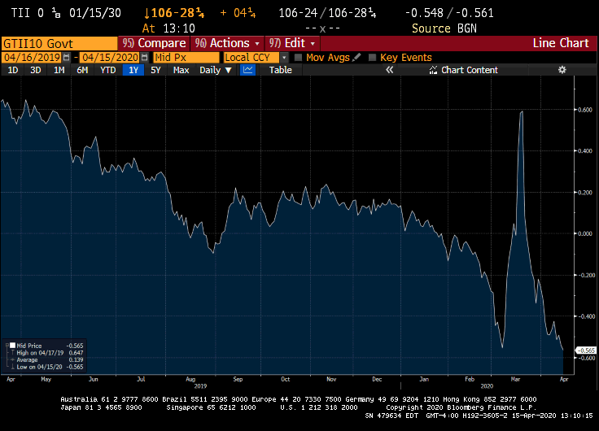
U.S. investors were panic selling some of the stock of outstanding debt

Slide 22
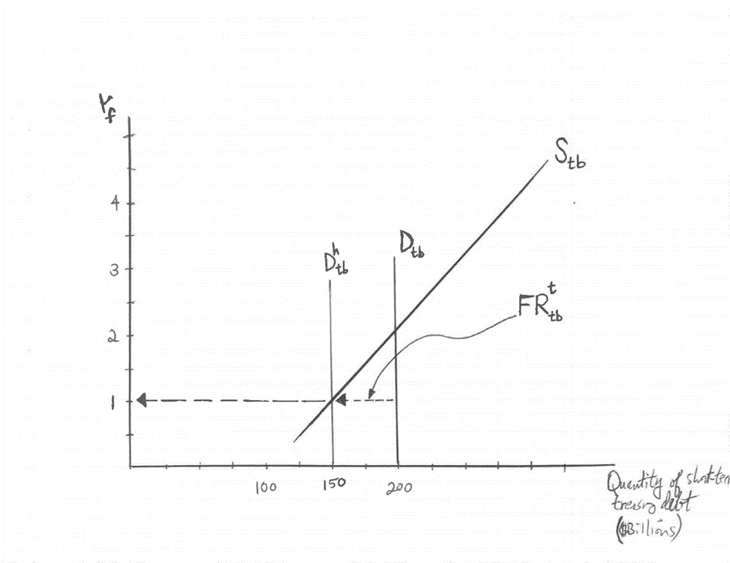
An example of Fed buying, removing the need for household funds, and lowering the equilibrium interest rate:

Slide 23
How monetary policy operates
IN NORMAL TIMES
Think of an individual investor. She has an opinion about how much risk to take:
2% risk-free bills, she commits 20% of her funds
3% risk-free bonds, she commits 30% of her funds
5% risky bonds, she commits 50% of her funds
Now the rate on t-bills has been pushed down to 1%, via Fed open market operations.
She will likely supply less in the t-bill market, given this lower rate of return. We see this as a movement along households’ supply curve for t-bills. Now money previously invested in t-bills shifts, and is invested in the t-bond and corporate bond market. Thus we have an outward shift for the bond market supply curves.

Slide 24
Monetary Policy Amid the Zero Bound, in 2010
How can the Fed get long term real rates lower, if it can’t lower fed funds?
Nominal π real
Fed funds: 0% 2% -2%
10-year t-bond: 2% 2% 0%
Baa bond: 5% 2% 3%

