Slide 1
Corporate Equities, Investment Trends and Capitalist Finance
And how can we make sense of stock prices today,
In the midst of the economy’s COVID-19 medically induced coma?
April 8th 2020

Slide 2
We now need to add equity markets to our stylized model of finance. We build up from investing in a hard asset, to investing in equity shares:
A company can choose to borrow to finance a project.
As economic forecasters, we need to recognize that two drivers overwhelmingly determine business investment decisions:
`estimated cash flows
the discount rate.
Both cash flow conjecture and discount rates are highly pro-cyclical.

Slide 3
If we embrace the efficient market hypothesis, shares reflect discounted present values of expected future earnings
PV (A,r,n) = (A/r)×[1-(1/(1+r))^{n}]
A ≡ annual net income
r ≡ discount rate
n ≡ number of years

Slide 4
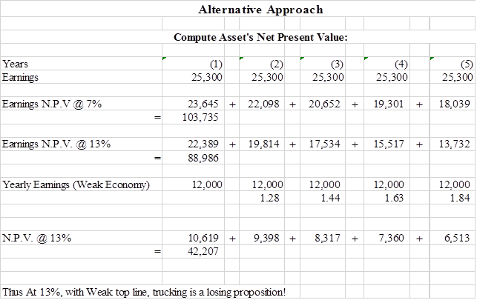
The N.P.V. of a $50,000 truck?
Depends on earnings and discount rates:

Slide 5
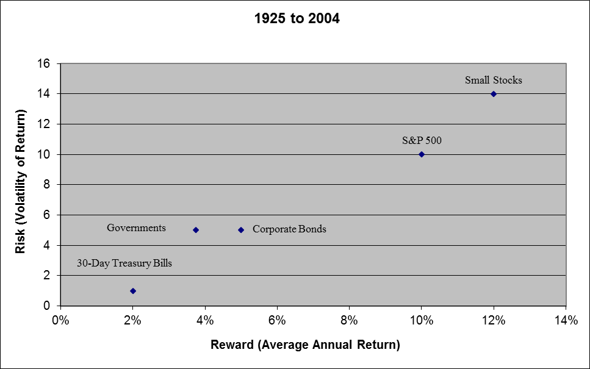
Risk and reward:

Slide 6
The equity risk premium:

Slide 7
Equity share prices, EMH says, reflect expected profits, discounted

Slide 8
When forecasting profits, we acknowledge two truths about profits:

Slide 9
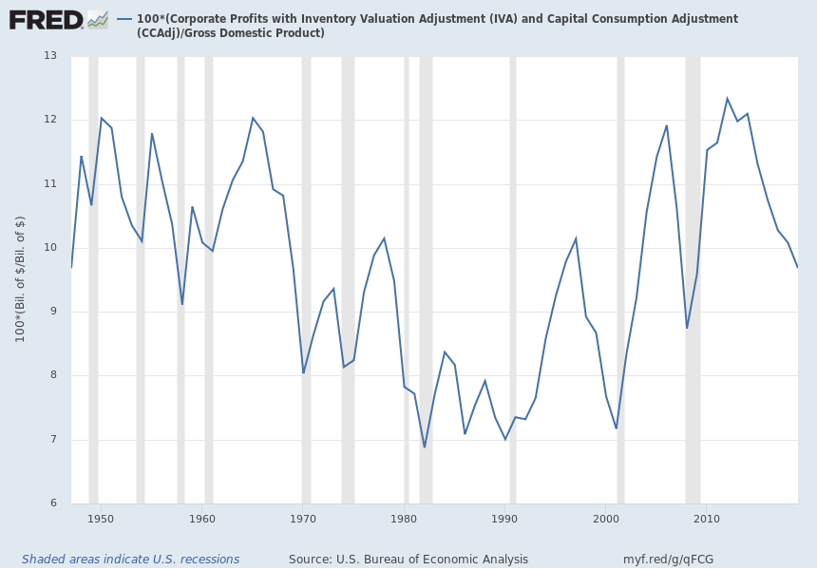
Notes:
Source:
U.S. Bureau of Economic Analysis
Release:
Gross Domestic Product
Units:
Billions of Dollars, Seasonally Adjusted Annual Rate
Frequency:
Quarterly
BEA Account Code: A191RCGross domestic product (GDP), the featured measure of U.S. output, is the market value of the goods and services produced by labor and property located in the United States.For more information, see the Guide to the National Income and Product Accounts of the United States (NIPA) and the Bureau of Economic Analysis.
U.S. Bureau of Economic Analysis,
Gross Domestic Product [GDP],
retrieved from FRED,
Federal Reserve Bank of St. Louis;
https://fred.stlouisfed.org/series/GDP,
April 8, 2020.
Source:
U.S. Bureau of Economic Analysis
Release:
Gross Domestic Product
Units:
Billions of Dollars, Seasonally Adjusted Annual Rate
Frequency:
Quarterly
BEA Account Code: A051RCA Guide to the National Income and Product Accounts of the United States (NIPA) - (http://www.bea.gov/national/pdf/nipaguid.pdf)
U.S. Bureau of Economic Analysis,
Corporate Profits with Inventory Valuation Adjustment (IVA) and Capital Consumption Adjustment (CCAdj) [CPROFIT],
retrieved from FRED,
Federal Reserve Bank of St. Louis;
https://fred.stlouisfed.org/series/CPROFIT,
April 8, 2020.

Slide 10
Equity Risk Premium
= (earnings yield) - (risk free real yield)

Slide 12
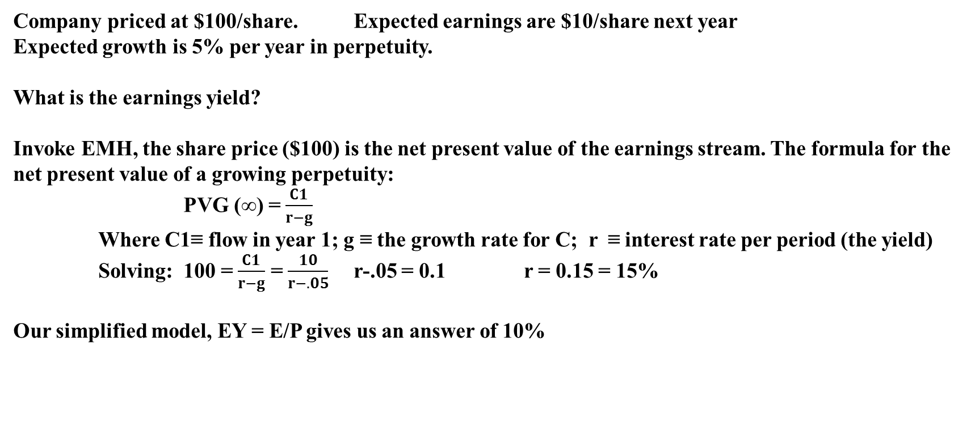
Company priced at $100/share. Expected earnings are $10/share next year
Expected growth is 5% per year in perpetuity.
What is the earnings yield?
Invoke EMH, the share price ($100) is the net present value of the earnings stream. The formula for the net present value of a growing perpetuity:
PVG (∞) = $\frac{C1}{r−g}$
Where C1≡ flow in year 1; g ≡ the growth rate for C; r ≡ interest rate per period (the yield)
Solving: 100 = $\frac{C1}{r−g}$ = $\frac{10}{r−.05}$ r-.05 = 0.1 r = 0.15 = 15%
Our simplified model, EY = E/P gives us an answer of 10%

Slide 14
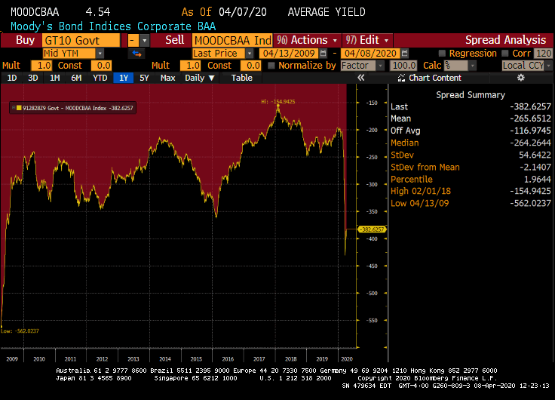

Slide 15
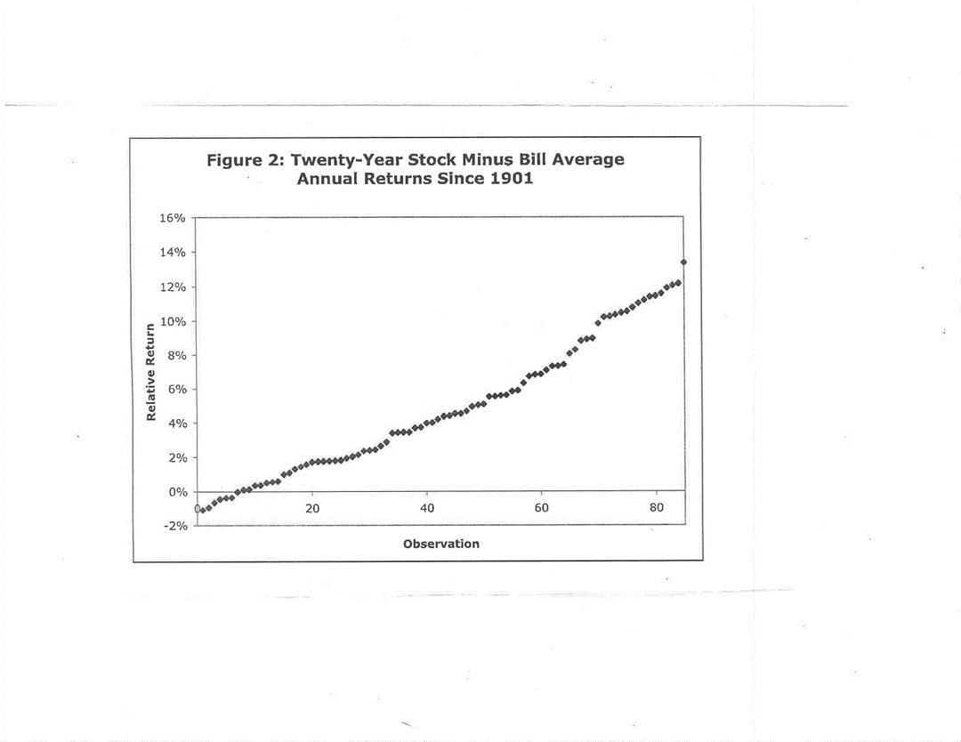
In the long run, stocks outperform with an insane degree of regularity

Slide 16
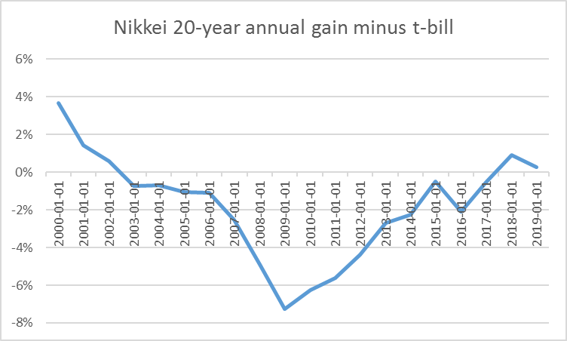
Stocks, long run, always outperform, except when they don’t
.

Slide 17
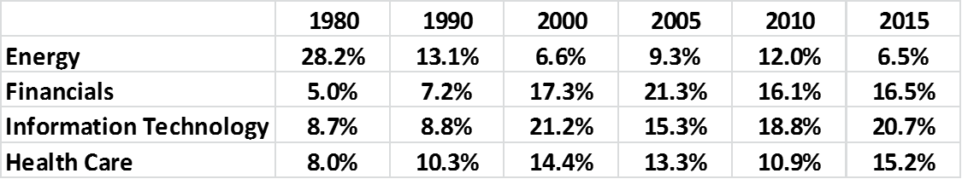

Slide 18
Allocating Capital and Tobin’s Q
Tobin’s Q is a measure of the market value compared to the replacement cost of a company’s assets
$1,000,000 of inherited money to form a small oil company.
The company erects 1 oil rig, at a cost of $1,000,000.
10,000 shares at $100 per share. His equity exactly equals the value of the sole asset, the oil rig.
Company sells oil at $50/bbl. osts are $30/bbl, netting him $20/bbl in profit.
Costs are $30/bbl. Profits are $20/bbl
In our super simplified example, the company has a Tobin’s Q of 1.
We assume the $100/share price correctly reflects the DPV of the stream of earnings that $50/bbl oil implies.

Slide 19
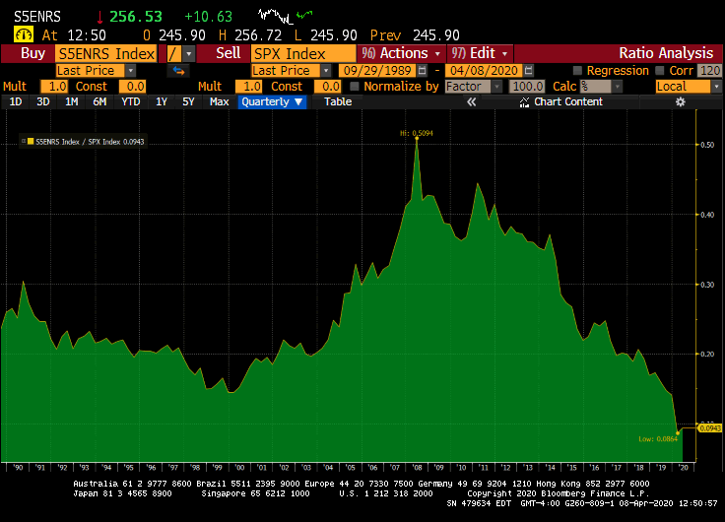

Slide 21
Now we have a shock. Chinese and Indian consumers begin to drive motor vehicles. Oil leaps to $100/bbl.
The company now generates $70/bbl in profit. The DPV of this more than tripling of cash flow causes his share price to triple.
What happens to the Q ratio of Ollie’s company? The market value of Ollie’s stock is now $3,000,000. The replacement cost to build another rig remains at $1,000,000.
Thus the Q ratio is now 3. When the Q ratio is well above 1, it is in the shareholders’ interest to sell equity and invest in additional physical capital.

Slide 22
We can issue 3,333 additional shares at $300 per share, raising another $1,000,000, using proceeds to build a second oil rig, and doubling corporate earnings.
Earnings double, but the original owner collects 2/3s of the earnings—the tripling of the share price means only 1/3 of the number of shares were issued for $1,000,000 to drill.s.
More generally, when the q ratio is well above 1, the equity cost of capital is low and investment climbs in said area. So a leap in oil prices drives share prices higher, inviting equity issuance to finance bricks and mortar—or deep water oil rig—investments
What happens if share prices plunge? If you have company with a Q ratio well below 1, there is no incentive to expand productive capability. If a factory cost $1,000,000 to reproduce, and the market capitalization of the company is $600,000, and you have a hankering to be in that business, you can buy the factory, by buying the company for $600,000.

Slide 23
How does this relate to impact investing?
What happens if we sell shares?

