Slide 1
The World of Finance: Interest Rates, Fixed Income Markets,
Real Rate/Real Growth Theory
Lecture 8
April Fools Day
2020

Slide 3
A quick Aside:
‘Real Interest Rates’
Ernie has $1,000, wants to buy a Moped.
Bert asks Ernie to lend him the $1,000.
‘I’ll repay the $1,000 plus $50 in interest.
Ernie decides he can get a helmet, if he waits.
So Ernie lends Bert $1,000 for one year.

Slide 4
Inflation Can Destroy
Purchasing Power
One year later Ernie collects $1050
He goes to buy he Moped.
But its now priced at $1,100
Ernie’s lament:
I got less than nothing for lending to Bert!
The moral: when you lend money you want to be paid ‘real’ interest.

Slide 5
The Fisher equation
i = r + I
Interest rate
  = real rate + inflation rate(expected)

Slide 6
Ex-Ante vs. Ex-Post Real Interest Rates
Ex-ante today: 10yr=0.6% // π_{e}=1.4% // Real_{ex-ante} = -0.8%
 | 10-Year | 12-Month | Actual | Ex-Ante | Ex-Post
 | Yield | Core | CPI | Real | Real
12-70 | 6.4 | 4.6 | 7.9 | 1.8 | -1.5
12-80 | 12.8 | 9.6 | 4.8 | 3.2 | 8
3-10 | 3.8 | 1.3 | ??? | 1.5 | ???

Slide 7
‘A Theory of Interest.
J. R. Hicks
The essential characteristic of a loan transaction is that its execution is divided in time.
The money rates of interest paid for different loans at the same date differ from one another for two main reasons:
(I) because of differences in the length of time for which loans are to run
(2) because of differences in the risk of default by the borrower.

Slide 8
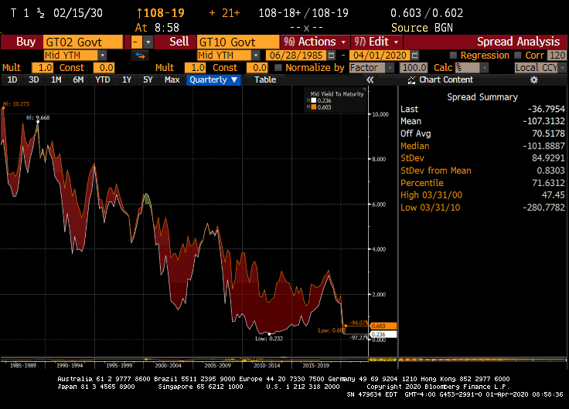
duration: term premium on average, 10 year yield is 1.07% above the 2-year yield

Slide 9
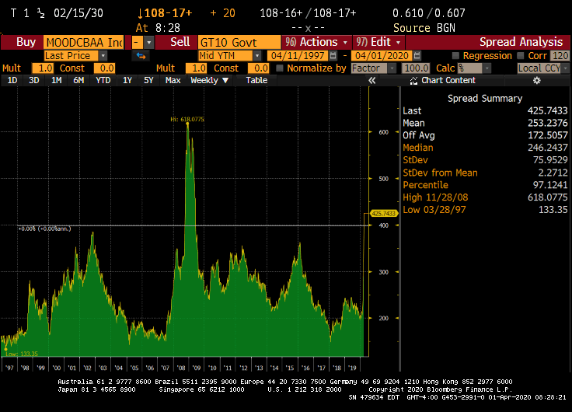
Default: Risk premium
Credit Spreads: How the Financial System Amplifies the Boom/Bust Cycle
(Moody’s Baa Yield) minus (U.S. treasury 10-year yield)
Credit spreads show us the risk premium investors demand, to lend to companies that have some chance of defaulting

Slide 10
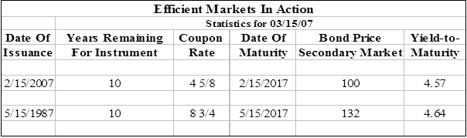
EFFICIENT MARKET HYPOTHESIS
Day to day we depend on the notion of informed investors repricing assets, so that they reflect all new information and make sense versus one another.
(look at today’s cash versus future price for oil)

Slide 11
How do we relate the real interest rates, r to real growth rates, y?
Samuelson’s overlapping generations model:

Slide 12
We now agree that optimal smoothing, in a world where no one is impatient, still results in a painful lifetime distribution of consumption: GORGE EARLY, STARVE LATER

Slide 13
Now we introduce money. Money allows us to save. The savings allow us to trade with the as yet unborn generation:
We will inject two doses of money into this economy.
We will impose a specific consumption pattern for gens A and B
In period 1, generation A is given $5.00
In period 2, both generation A and B are given $5.00
In years 1 and 2, Generation A consumes all of its production, and keeps its $10.
In year 2, Generation B consumes all of its production, and keeps its $5.00
In period 3, money begins to change hands.

Slide 14
What are the circumstances in place, in period 3?
Gen A has $10, will produce no output, will spend all $10.00.
Gen B has $5, will produce 100 units of output, will save the $5.00
Gen C has $0.00, will produce 100 units.

Slide 15
In period 3, what is the optimal money/goods trading strategy for generations A/B/C?
The young cohort (C) receives $5 from the old, for 33.3 chocolates.
Cohort C, therefore consumes 66.7 units, and saves $5.
The middle cohort (B) receives $5 from the old, for 33.3 chocolates.
Cohort B, therefore consumes 66.7 units, and now has $10.00 saved.
The oldsters (A) spend all their money, they consume 66.7 chocolates in their last year of life.
Now $10 buys you 66.7 units, the oldsters always have $10, and the system has perfectly smoothed consumption—thanks to the oldsters newfound ability to trade with the newly arrived producing generation.

Slide 16
Smoothed Consumption, with Climbing Productivity and a Rising Labor Force:
Population grows 5% per year.
Each new cohort is 5% more productive.
Output, after year 1, therefore, grows 10% per year:

Slide 17
Once again, we inject two doses of money, totaling $10/A, $5.70/B
Period 3, A buys 33 from B for $4.30, 44 from C, for $5.70
Now B has $10 and C has $5.70

Slide 18
Recall, however, that output rises 10%/period.
Period 4, total funds, $15, will buy more output.
In period 3:
CA buys 33 chocolates from CB for $4.30
CA buys 44 chocolates from CC for $5.70
Note: 1 chocolate = 13 cents
In period 4:
CB buys 36.3 chocolates from CC for $4.30
CB buys 48.3 chocolates from CD for $5.70
Note: 1 chocolate = 12 cents
In period 5:
CC buys 93 chocolates from CD and CE for $10.0
Note: 1 chocolate = 11 cents

Slide 19
We can now calculate this economy’s REAL INTEREST RATE.
Period to period, it cost you 10% more in output, to secure 1$.
Thus the real interest rate IS the economy’s real growth rate.

Slide 20
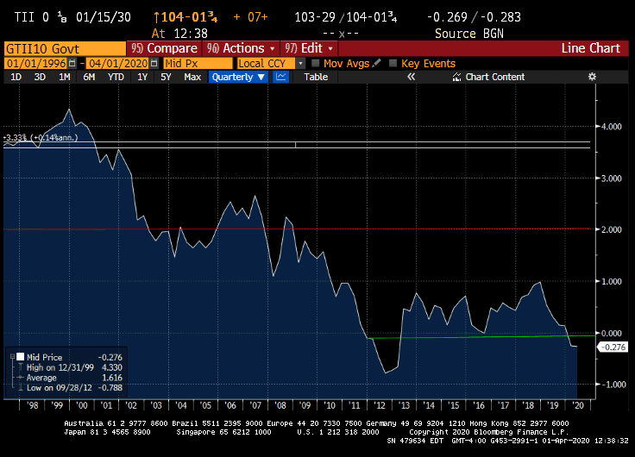
U.S. Treasury Inflation protected notes(TIPS)
Falling real borrowing rates:

Slide 21
Credit spreads provide us with market expectations of default probabilities:

Slide 22
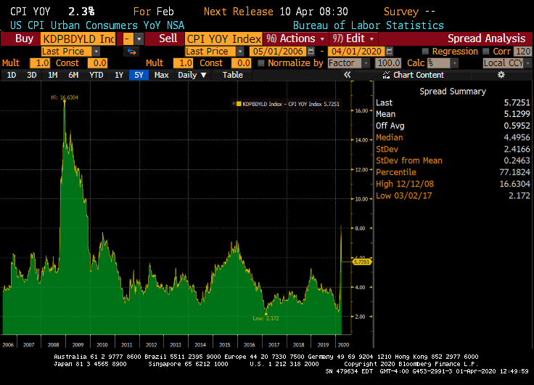
Real rate demanded of junk borrowers
2.35%, 2/15/20. 8%, 3/25/20

